Slide 1

#GAMEDEVS: AIM
HIGHER
Mike Acton
macton@insomniacgames.com
#AltDevBlogADay

Slide 2
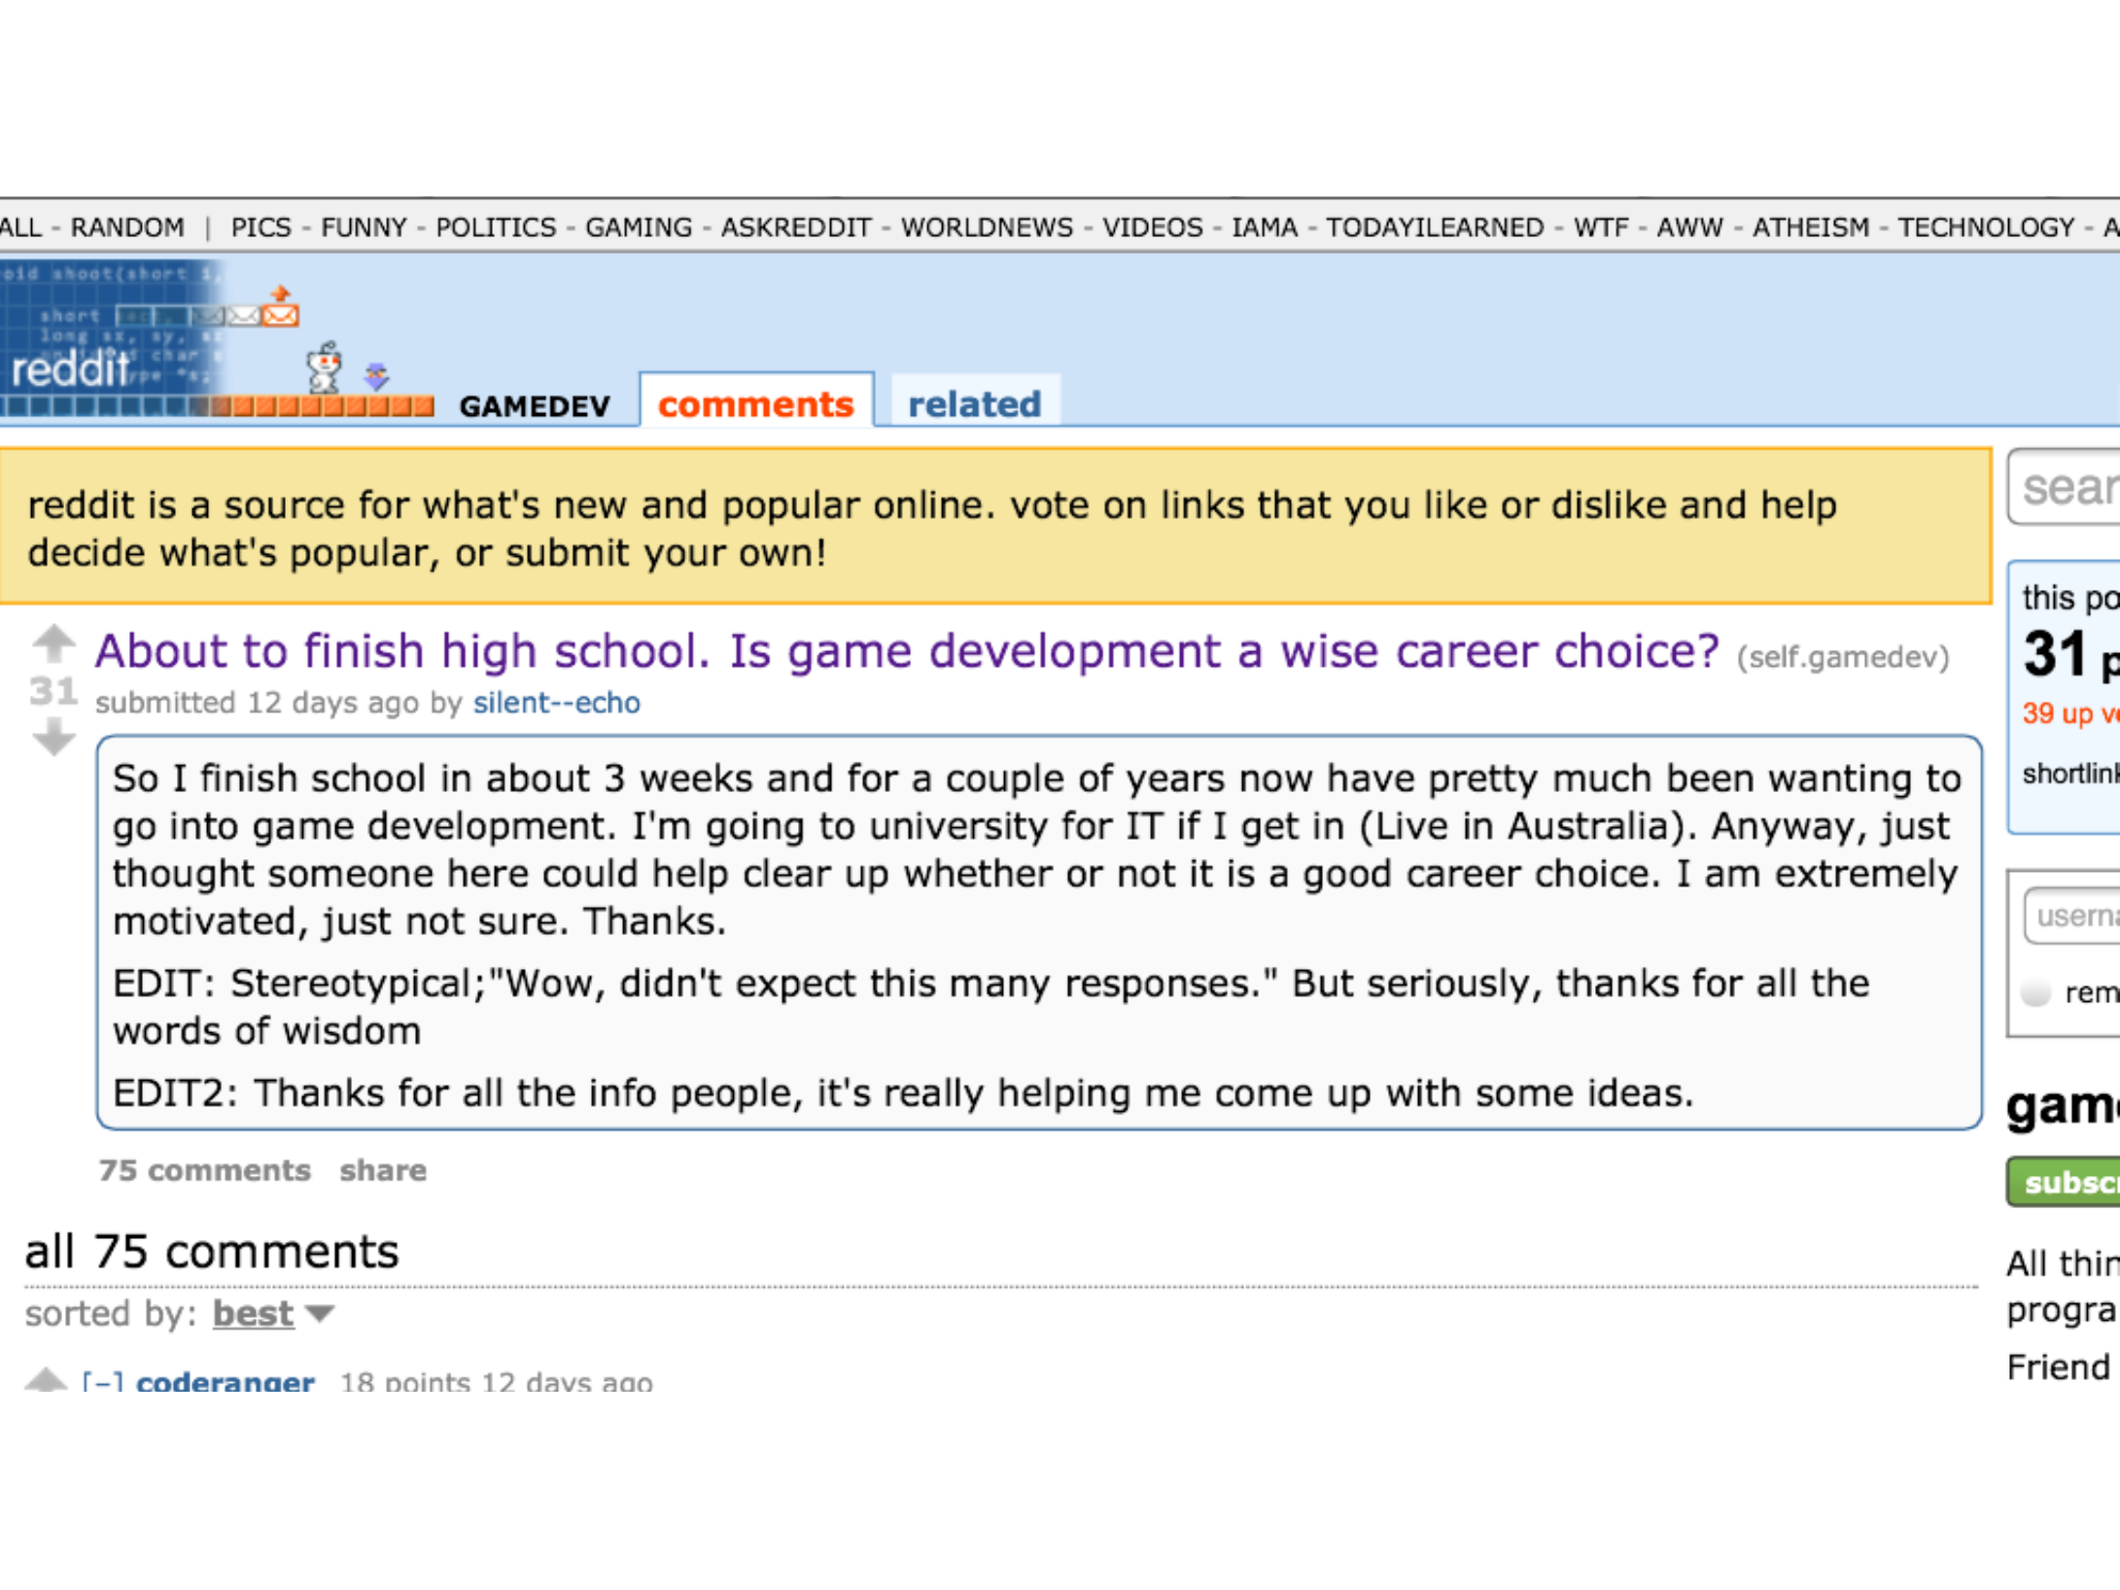

Slide 3
IS
IT?

Slide 4
DOES
IT
MATTER?

Slide 5
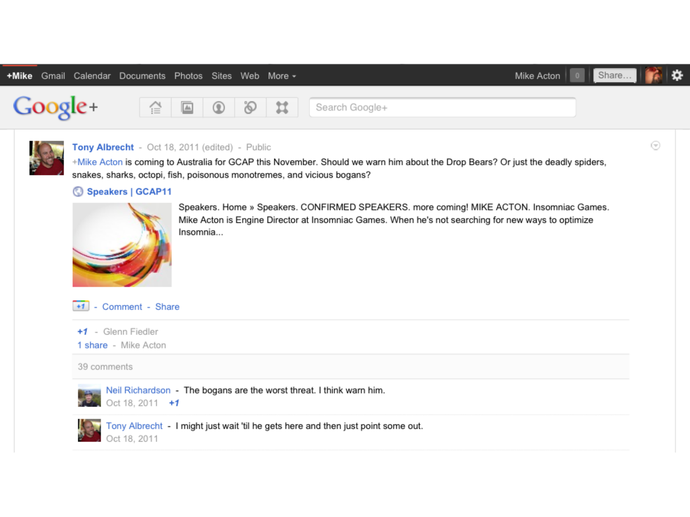

Slide 6
AUSDEV
SCENE
DEAD?

Slide 7
AAA ENDANGERED?
Console sandbox; Are we console devs?

Slide 8
INTERNATIONAL
INVESTMENT?
...goes to the talent

Slide 9
LOCAL
EDU?
...other options? Collaboration. Mentoring.

Slide 10
HIGH
AUSTRALIAN
DOLLAR
Are you a commodity?

Slide 11
POPULATION

Slide 12
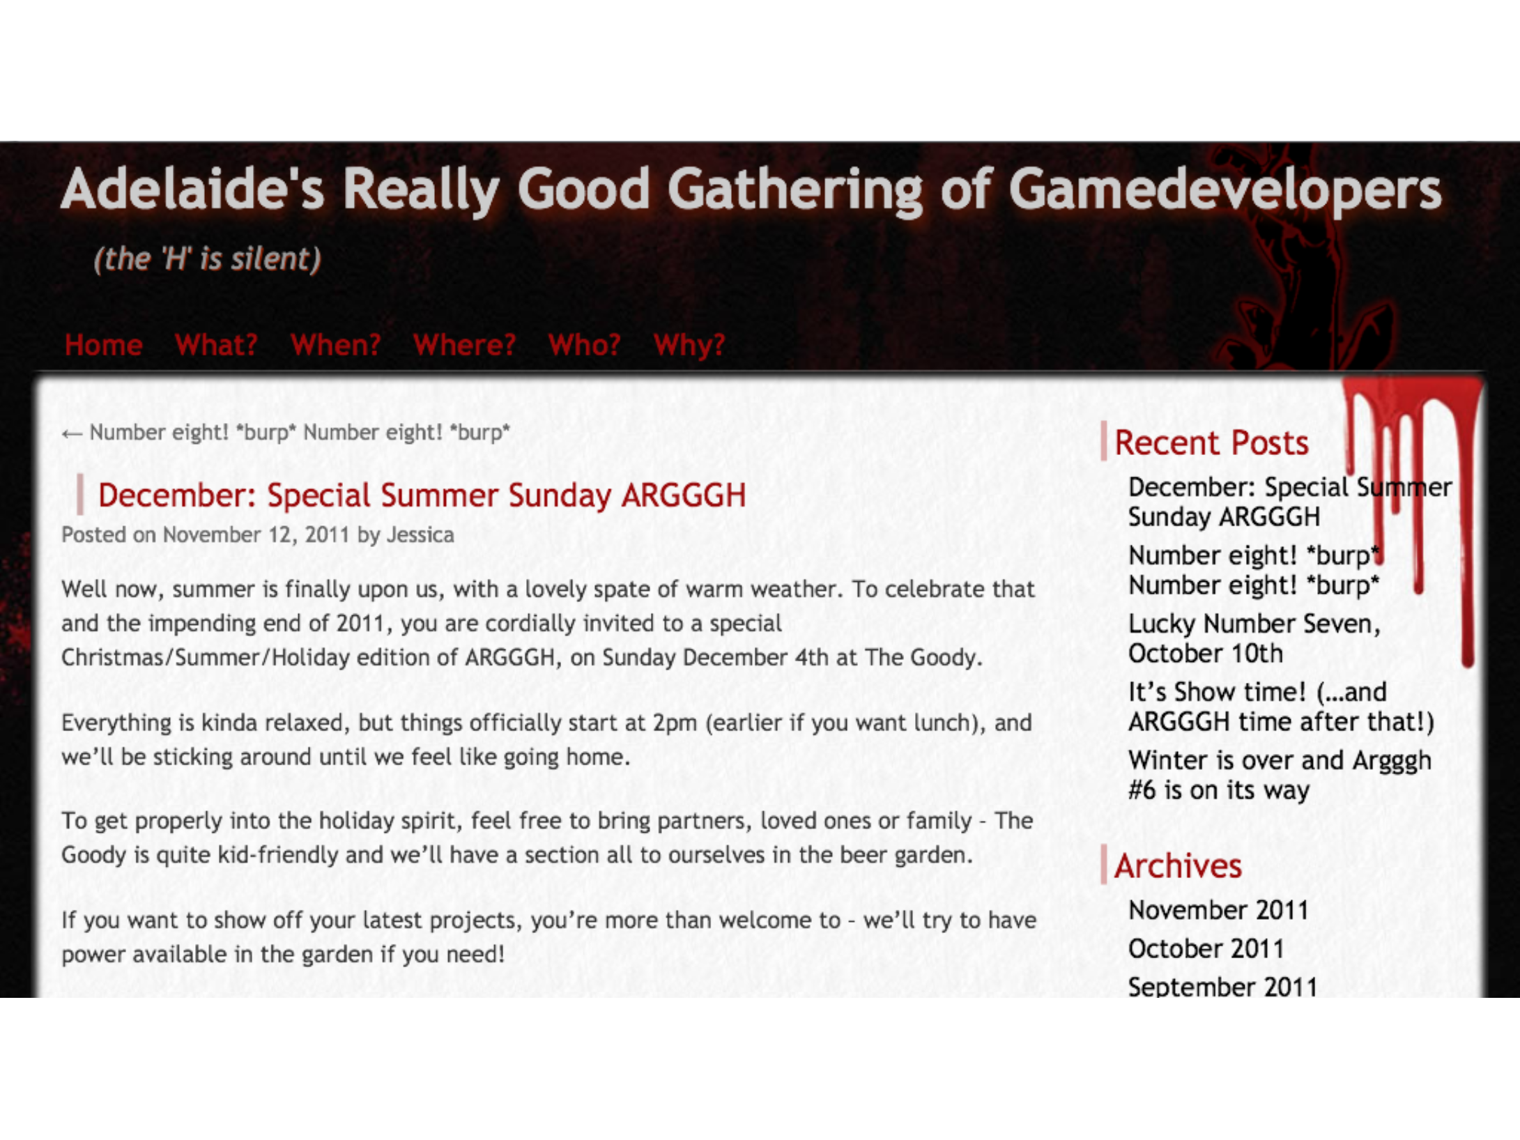

Slide 13
NO
LOCAL
PUBLISHERS

Slide 14
NO
LOCAL
CONSOLES

Slide 15
CAUSE FOR HOPE:
PASSION
AND TALENT.

Slide 16
PUT THAT
ASIDE...

Slide 17
GAMES
HAVE
WON

Slide 18
INDIES

Slide 19
SERIOUS
GAMES

Slide 20
SOCIAL
AND
MOBILE

Slide 21
GAMIFICATION

Slide 22
CHANGE THE
WORLD?

Slide 23
NOW:
GET
OUT
OF
OUR
OWN
WAY.
Holding ourselves back.

Slide 24
TAKE-AWAY:
JUST THINK TWO
POINTS

Slide 25
AIM
HIGHER
Invisible class system?

Slide 26
CHANGE
IS YOUR
OWN
RESPONSIBILITY

Slide 27
WHERE TO
START?
ASK THE
RIGHT
QUESTIONS.

Slide 28
WHY
AM
I
HERE?

Slide 29
WHAT
AM
I
PASSIONATE
ABOUT?

Slide 30
WHAT
DRIVES
ME?

Slide 31
WHAT'S
IMPORTANT TO
ME?

Slide 32
WHAT
INSPIRES
ME?

Slide 33
HOW
CAN
I
MAKE
AN
IMPACT?

Slide 34
HOW
CAN
I
MAKE
A
*BIGGER*
IMPACT?

Slide 35
WHAT
DO
I
HAVE TO
SAY?

Slide 36
AIMING
HIGHER:
AS
AN
INDIVIDUAL

Slide 37
BE THE TALENT
Brand isn't a bad word.

Slide 38
BRAND
•
As a loss leader (overhead cost)

Slide 39
VALUE YOUR VOICE

Slide 40
PARTICIPATION

Slide 41
COLLABORATION

Slide 42
WHAT'S YOUR
WORTH?
...just your skills?

Slide 43
INDIVIDUAL
OR
STUDIO:
YOU
HAVE TO
ANSWER.

Slide 44
SKILLS
OUT
OF
DATE

Slide 45
MAKE
WHAT YOU
DO
NOW
COMMODITY

Slide 46
SKILL
IS
CHANGE

Slide 47
WHAT
DO YOU
WANT
TO
CHANGE?

Slide 48
ME:
POSITION
OF
GAMES

Slide 49
ME:
HOW
WE
DEVELOP

Slide 50
ME: WASTED
EFFORT

Slide 51
ME:
POP
CULTURE

Slide 52
BE
AMBITIOUS

Slide 53
HAVE
A
STRATEGY

Slide 54
AIM
HIGHER:
AS
STUDIOS

Slide 55
NOT
A
ZERO
SUM
GAME

Slide 56
HOW
WE
REFLECT THE
WORLD
AROUND
US?

Slide 57
CULTURE:
CONNECTED
AND
ENTITLED

Slide 58
VALUE
BEYOND
FEATURES
Hard features -> Soft

Slide 59
HAVE
SOMETHING TO
SAY.

Slide 60
EMOTIONAL
IMPACT
BEYOND
STORY

Slide 61
MEASURING THE
WRONG THINGS.
E.g. Metacritic. Unit sales.

Slide 62
BRANDS.
(NOT
JUST
IP)
E.g. Coca Cola

Slide 63
GAMEDEV
BRANDS
>
HARDWARE
BRANDS

Slide 64
WHAT
DO
PUBLISHERS
WANT?

Slide 65
GIVE
UP
PLAYER-TRUST
NETWORK TO
PUBS?

Slide 66
MONETIZATION...
...is not a bad word.

Slide 67
YOU
WILL
BE
OUT
SPENT.

Slide 68
BE
WHERE THE
ARE
PLAYERS

Slide 69
TAKE-AWAY:
JUST THINK TWO
POINTS

Slide 70
AIM
HIGHER
Invisible class system?

Slide 71
CHANGE
IS YOUR
OWN
RESPONSIBILITY

Slide 72
THANKS!
Twitter : @mike_acton

